Slide 1

HR Analytics Dashboard Report: Employee Attrition Analysis
This comprehensive HR analytics dashboard report provides an in-depth analysis of employee attrition trends within the organization. By examining key metrics, demographic factors, and root causes, the report aims to uncover actionable insights for reducing turnover and retaining top talent.

Slide 2
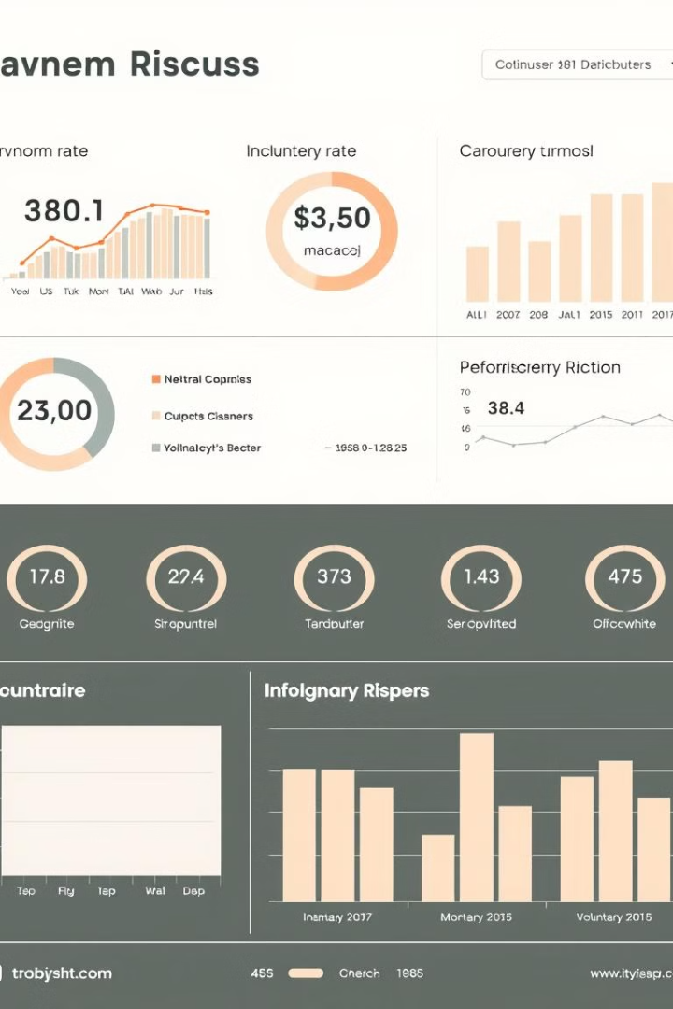
Key Attrition Metrics
Turnover Rate
Voluntary Turnover
The overall percentage of employees who have left the organization during a given time period.
The percentage of employees who have chosen to leave the organization on their own accord.
Involuntary Turnover
The percentage of employees who have been terminated or laid off by the organization.

Slide 3
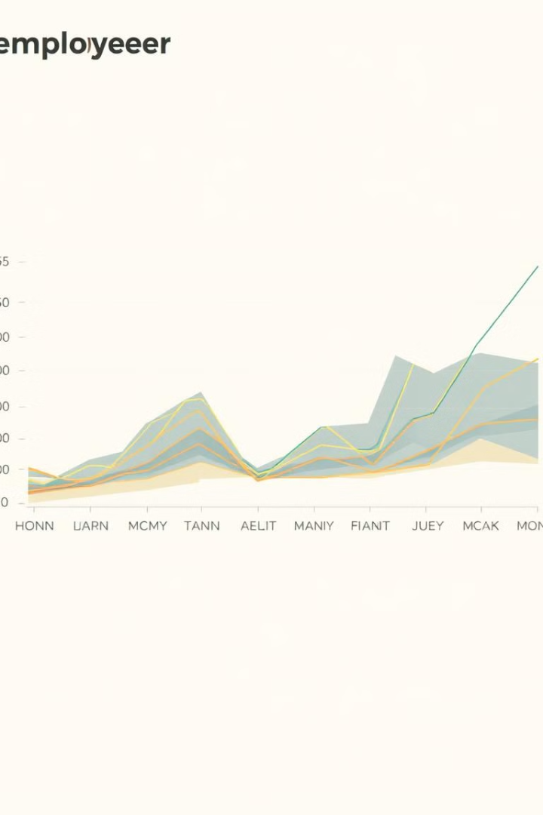
Attrition Trend Analysis
1
12-Month Trend
Analyze the overall turnover rate over the past 12 months to identify any significant patterns or fluctuations.
2
Departmental Comparisons
Compare turnover rates across different departments to uncover any notable variations or pain points.
3
Identify Opportunities
Use the trend analysis to pinpoint areas where targeted retention efforts could have the greatest impact.

Slide 4
Demographic Factors
Age
Tenure
Gender
Examine the distribution of employee ages and how it correlates with attrition rates.
Identify patterns in turnover based on the length of time employees have been with the organization.
Analyze any gender-based differences in attrition to ensure equitable retention practices.

Slide 5

Root Cause Analysis
1
Top Reasons for Leaving
2
Exit Interview Insights
Identify the primary factors that are driving employees to leave the organization.
Leverage feedback from departing employees to uncover deeper insights into the attrition problem.
3
Understand Underlying Causes
Analyze the root causes behind employee turnover to develop targeted retention strategies.

Slide 6


High-Risk Attrition
Identification
Pinpoint employees who exhibit the highest risk of leaving the organization.
Early Warning
Proactively monitor these high-risk employees to enable timely intervention.
Targeted Retention
Develop personalized strategies to address the specific needs of high-risk employees.

Slide 7

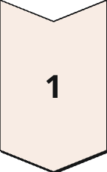
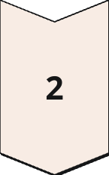
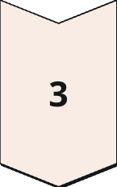
Recommendations for Reducing Turnover
Competitive Compensation
Ensure salaries and benefits are aligned with industry benchmarks to attract and retain talent.
Career Development
Provide clear paths for advancement and opportunities for professional growth.
Improved Work-Life Balance
Implement flexible work arrangements and promote a healthy work-life integration.

Slide 8

Conclusion
This HR analytics dashboard report has provided a comprehensive analysis of employee attrition within the organization. By uncovering key insights and trends, we can now develop targeted retention strategies to address the root causes of turnover and ensure the long-term success and stability of our workforce.
The next steps involve implementing the recommended approaches and closely monitoring their effectiveness. Continuous evaluation and refinement of our retention efforts will be crucial to maintaining a highly engaged and committed team.

